Slide 1
Advanced Computer Architecture
Sandesh Shrestha
BEG478CO
Year: IV
Semester: II

Slide 2
Advanced Computer Architecture
Board Exam Questions patterns
Total 10 questions and 8 questions to solve 10*8=80 marks
Students’ Work
It should consist of minimum 10-12 assignments with emphasis on solving problems.

Slide 3
Reference Books :
Advanced computer architecture – Kai Hwang (MGH).
Computer Architecture and Parallel Processing – Kai Hwang And Briggs (MGH).
Advanced computer Architecture – Dezso Sima, Terence Fountain & Peter Kacsuk (Pearson Education)
Parallel Programming Techniques & Applications using Networked Worksataions & Parallel Computers-Barry Wilkinson & Michael Allen–Second Edition (Pearson Education).
Introduction to Parallel Processing – M. Sasikumar, D. Shikare & P. Ravi Prakash (PHI).
Internet for Open MP, Hadup and others.

Slide 4
Course Objective
Learn and appreciate computer architecture with an emphasis on system design, performance and analysis.
Elevate thinking process to the level of performance improvement techniques for recent multi-core architecture.
Enable exploration of future directions in computer architecture research.

Slide 5
1.Concept
Original sense: – Taking a range of building materials, putting together in desirable ways to achieve a building suited to its purpose

Slide 6
In Computer System:
Similar: how parts are put together to achieve some overall goal
Examples: the architecture of a chip, of the Internet, of an enterprise database system, an email system, a cable TV distribution system
Adapted from David Clark’s, What is “Architecture”?

Slide 7
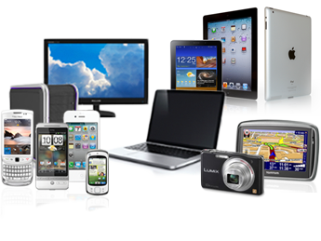

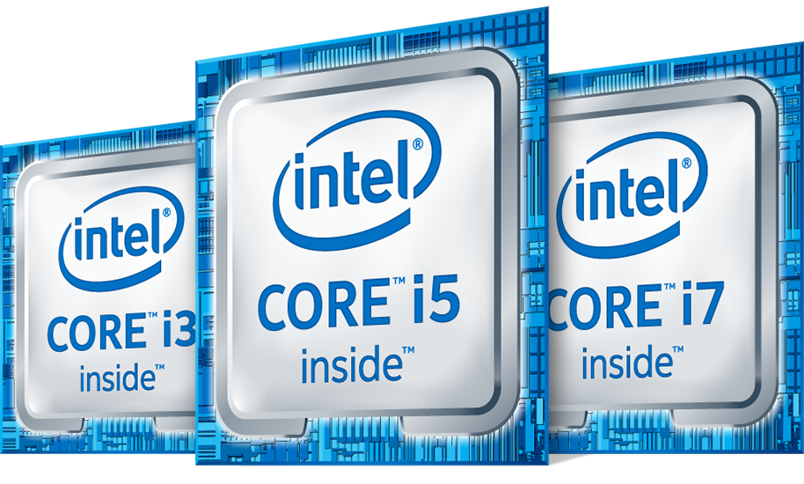
Role of Computer Architects
Applications and hand held devices are the part and parcel of our day to day life

Slide 8
Why Computer Architecture?
Exploit advances in technology
– Make things Faster, Smaller, Cheaper, …
Which enables new applications
– Life-like 3D games 15 years ago?
Make new things possible
– Smart dust? Accurate one-month weather forecasts? Cure for cancer?
The advancement of computer architecture is vital for the advancement of all other areas of computing!

Slide 9
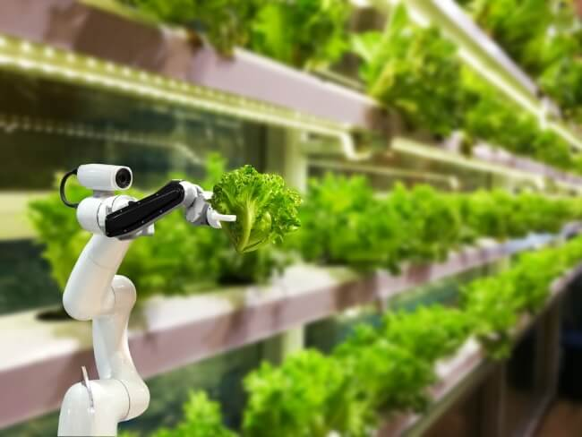
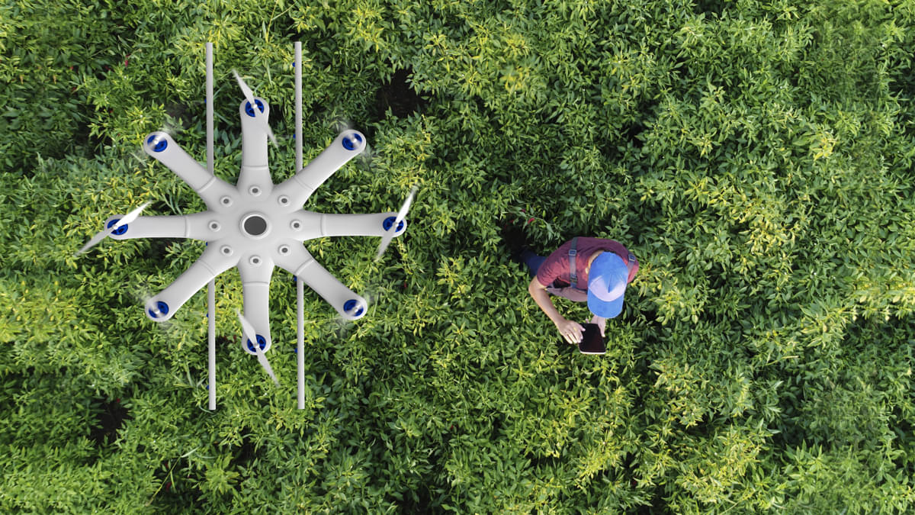
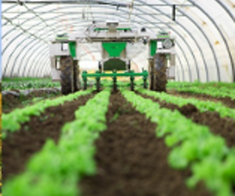
Key Applications in the future decade
Agritronics (Smart Farming)

Slide 10

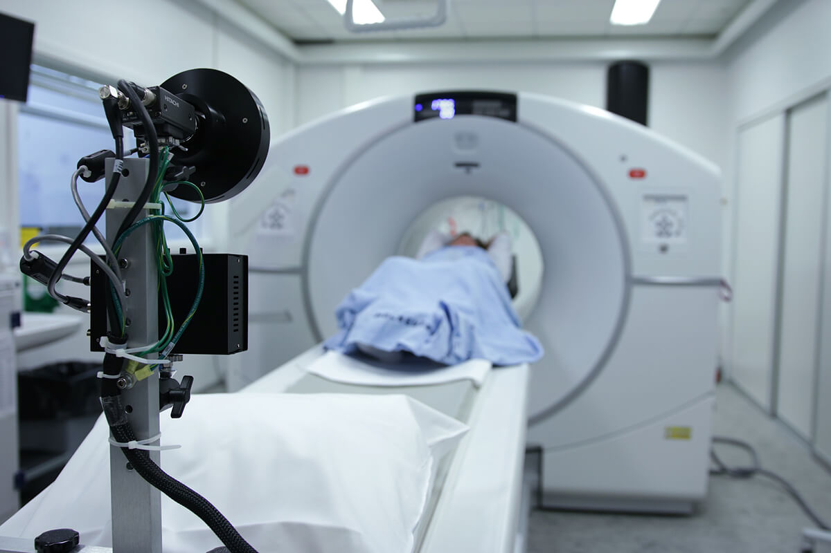
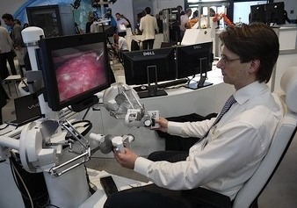
Smart Health Care

Slide 11
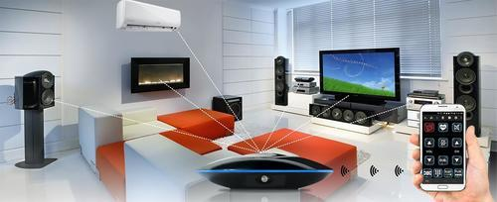
Smart Homes (Home Automation)

Slide 12
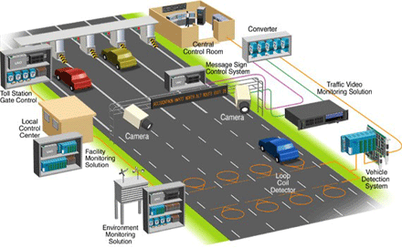

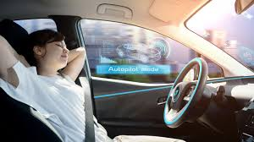
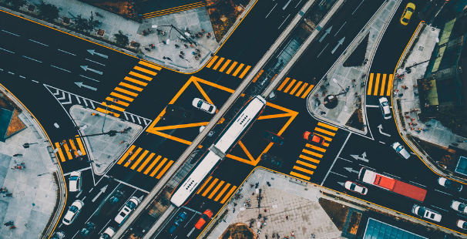
Intelligent Transportation

Slide 13

High Precision Security

Slide 14
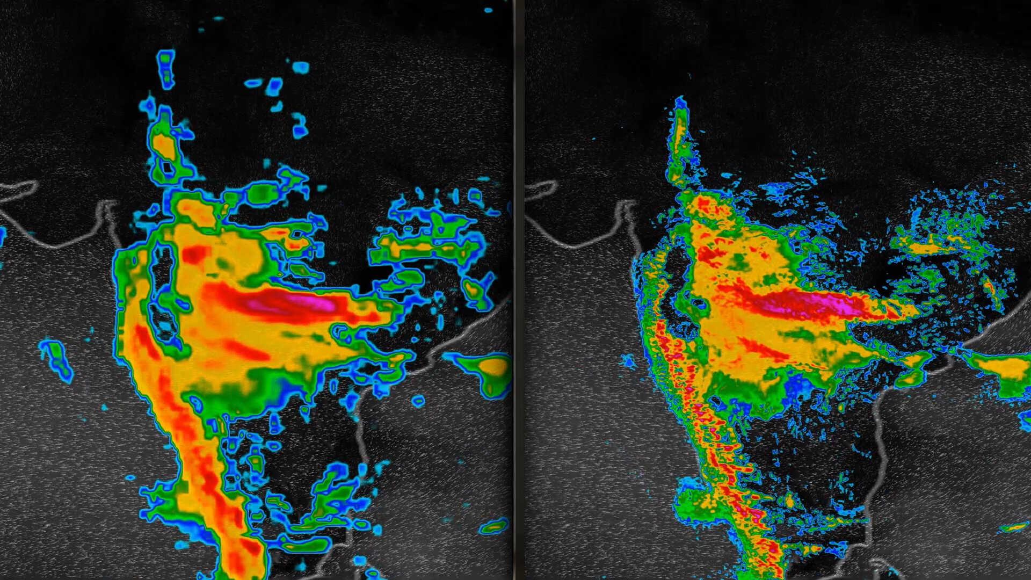
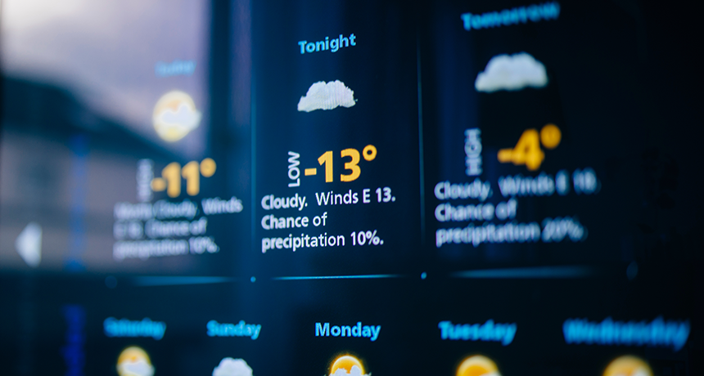
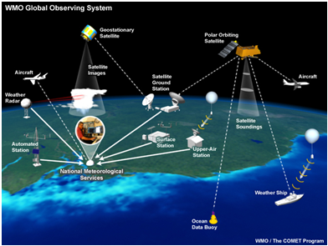
Weather Forecasting

Slide 15
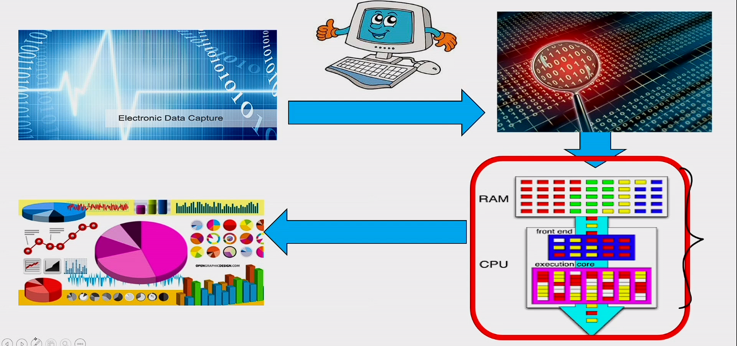
How are all these done?

Slide 16
Review: Some Basic Definitions
Kilo byte – 2¹⁰ or 1,024 bytes
Megabyte – 2²⁰ or 1,048,576 bytes
– sometimes “rounded” to 10⁶ or 1,000,000 bytes
Gigabyte – 2³⁰ or 1,073,741,824 bytes
– sometimes rounded to 10⁹ or 1,000,000,000 bytes
Terabyte – 2⁴⁰ or 1,099,511,627,776 bytes
– sometimes rounded to 10¹² or 1,000,000,000,000 bytes
Petabyte – 2⁵⁰ or 1024 terabytes
– sometimes rounded to 10¹⁵ or 1,000,000,000,000,000 bytes
Exabyte – 2⁶⁰ or 1024 petabytes
– Sometimes rounded to 10¹⁸ or 1,000,000,000,000,000,000 bytes

Slide 17
Background
Transistor
Logic

Slide 18
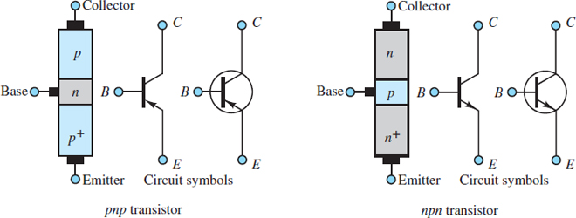
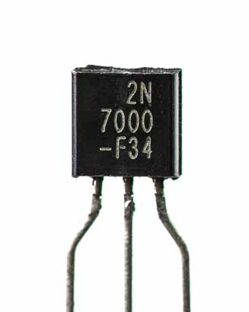
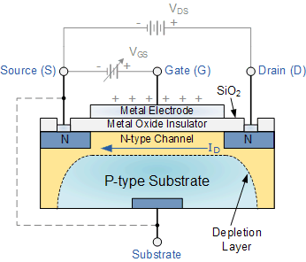
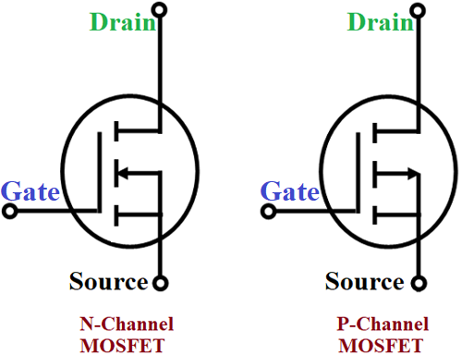
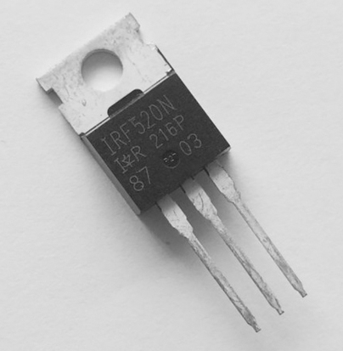
Transistor

Slide 19
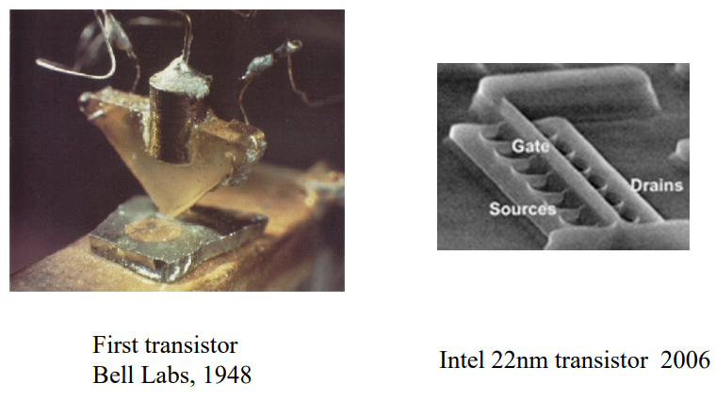
What’s the culprit in computer’s performance?

Slide 20
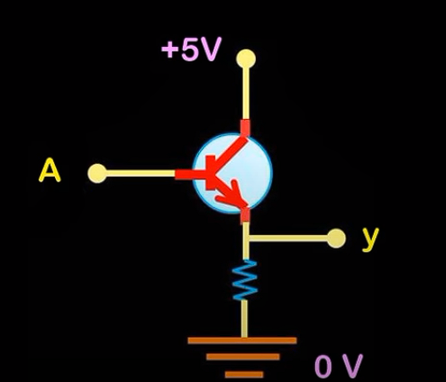
Buffer

Slide 21
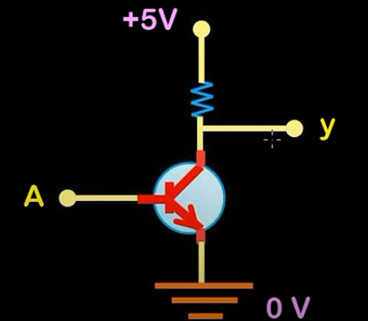
Inverter

Slide 22
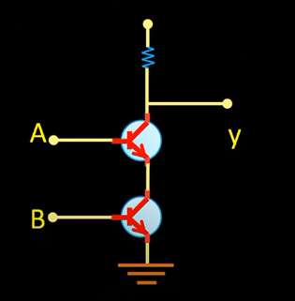
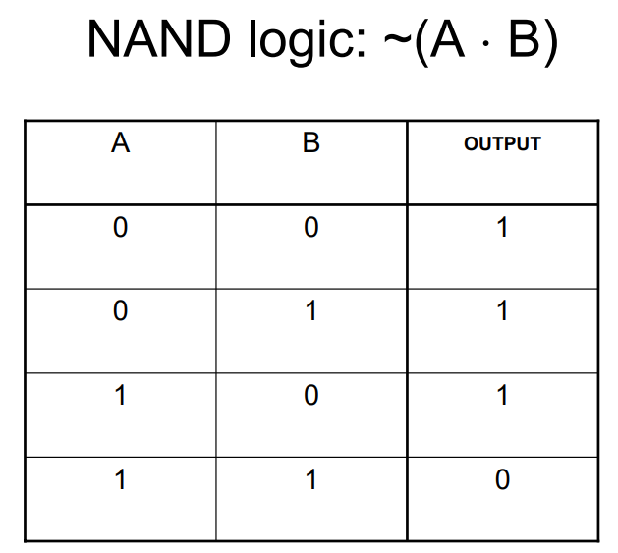
NAND gate

Slide 23
NOR gate

Slide 24
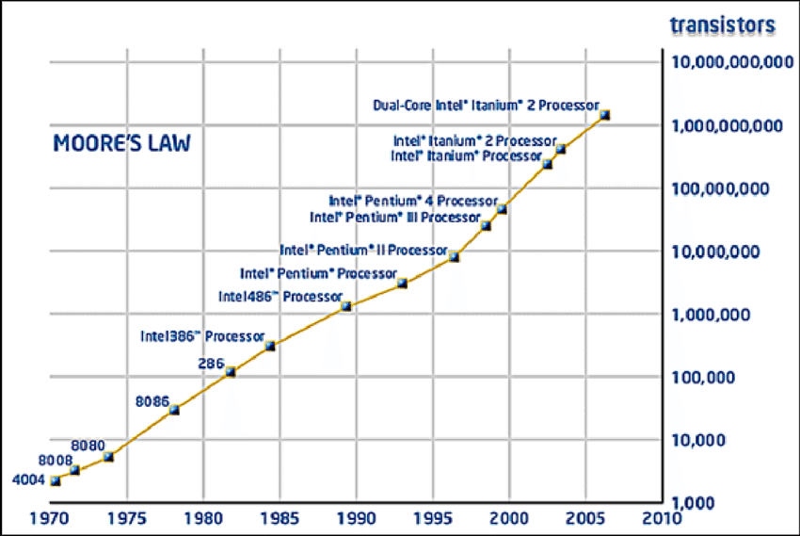
What is Moore’s Law?
In 1965, Intel’s Gordon Moore predicted that the number of transistors that can be integrated on single chip would double about every two years.

Slide 25
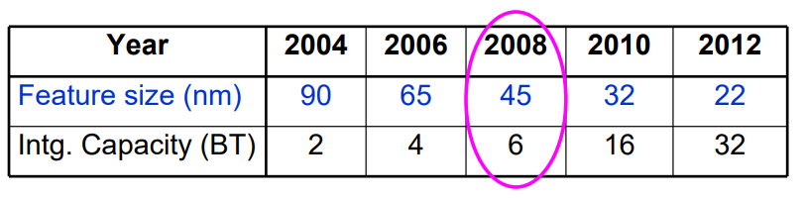
Technology Scaling Road Map (ITRS)
• Fun facts about 45nm transistors
– 30 million can fit on the head of a pin – You could fit more than 2,000 across the width of a human hair
– If car prices had fallen at the same rate as the price of a single transistor has since 1968, a new car today would cost about 1 cent

Slide 26
What’s the other implication of Moore’s Law (1965)?
Transistors per inch square
– Twice as many after ~1.5-2 years
Related trends
– Memory capacity
Twice as much in < 2 years
– Processor performance
Twice as fast after ~18 months

Slide 27
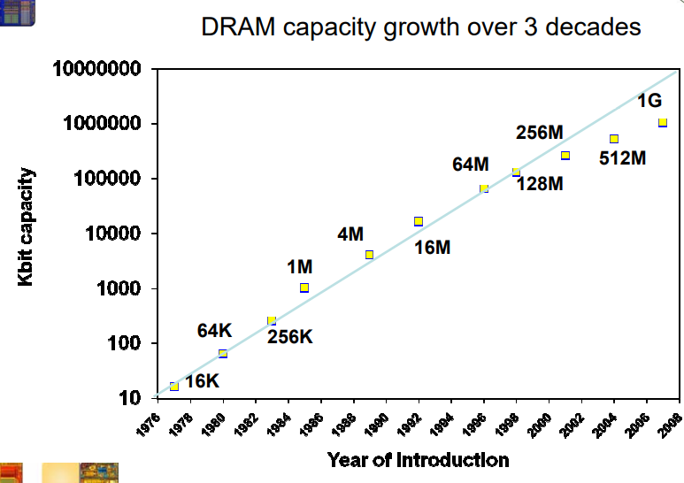
Another Example of Moore’s Law Impact

Slide 28
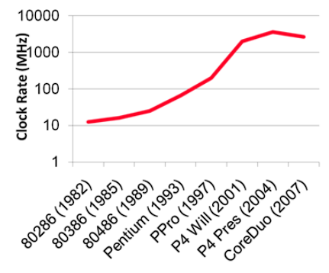
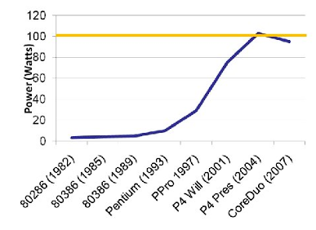
But What Happened to Clock Rates and Why?
Clock rates hit a “power wall”

Slide 29
“For the P6, success criteria included performance above a certain level and failure criteria included power dissipation above some threshold.”
Bob Colwell, Pentium Chronicles

Slide 30

How to use 1B (or more) transistors?
1. Instruction set architecture (ISA)
– interface between HW and SW
– different ISAs may be more/less effective for different target application areas
2. Microarchitecture
– Techniques below the ISA level (transparent)
– ex. pipelining, caching, branch prediction, superscalar, dynamic scheduling, clock-gating, …

Slide 31
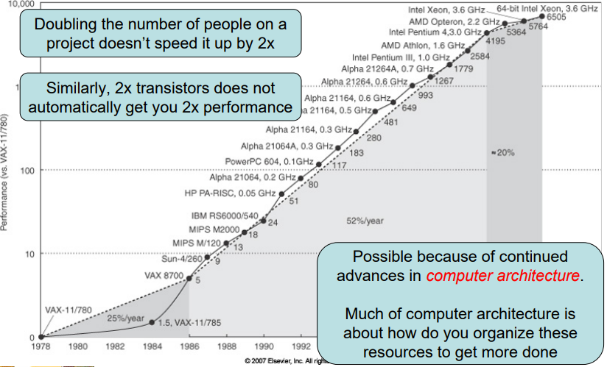
Performance Trend

Slide 32
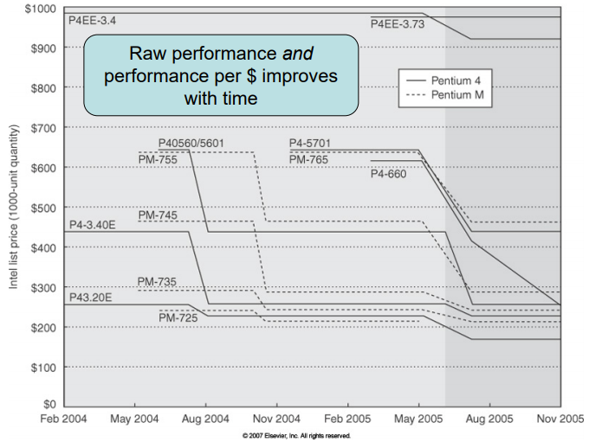
Price Trends

Slide 33
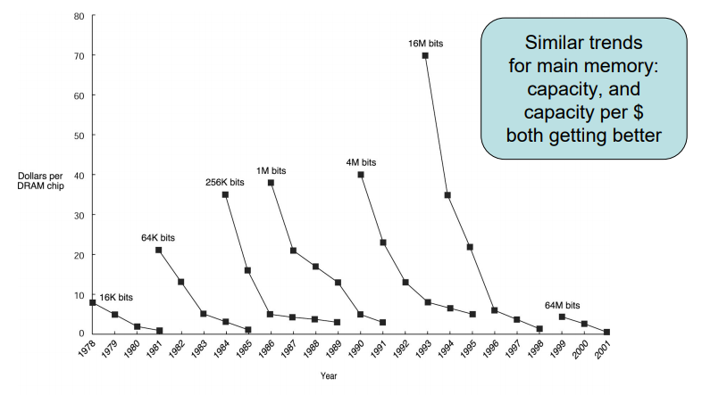
Price Trends (DRAM memory)

Slide 34
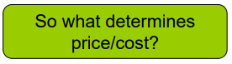
Why Do You Care About Prices?
Target market, target prices place a limit on the cost of my processor
– price = what I sell the part for
– cost = what it costs me
Design decisions affect the cost (and price)
– Ex. adding more cache may improve performance, but increase cost
Price-performance is often what we’re trying to balance

Slide 35
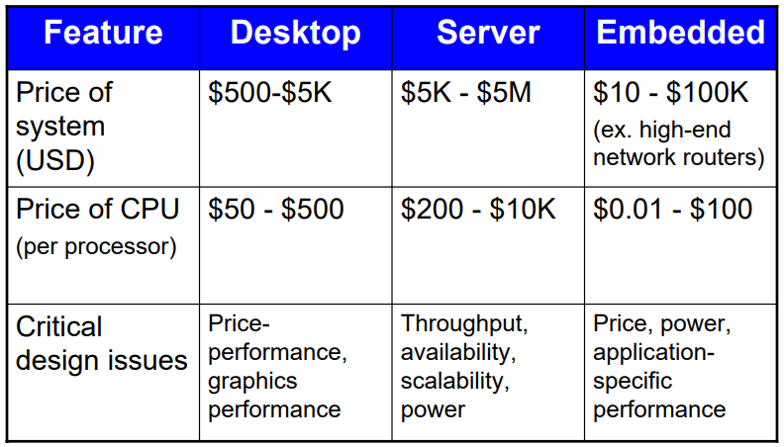
Depends on the Class of Processor

Slide 36
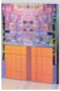
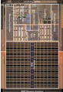
Desktop Systems
• Examples
– Intel Core 2 Duo
– AMD Opteron
• Applications: everything (general purpose) – Office, Internet, Multi-media, Video Games…
• Goals
– performance, price/performance
– power→ affects cost, noise, size

Slide 37
Servers
• Examples
– IBM Power
– Sun Niagara (T1)
– Intel Xeon
• Applications
– infrastructure: file server, email server, …
– business: web, e-commerce, databases
• Goals
– Throughput (transactions/second)
– Availability (reliability, dependability, fault tolerance …)
– Cost not a major issue
– But power is (power bill)

Slide 38
Embedded
• Examples
– Xscale, ARM, MIPS, x86, … (many varieties)
• Applications
– cell phones, mp3 players, game consoles, consumer electronics (refrigerator, microwave), automobiles, … (many varieties)
• Goals
– Cost, Power
– Sufficient performance, real-time performance
– Size (CPU size, memory footprint, chip count…)

Slide 39
How to make a microprocessor chip?

Slide 40
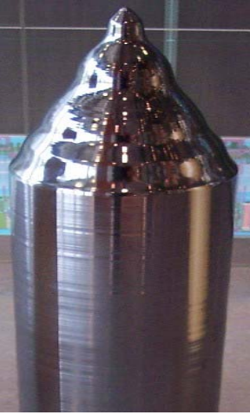
Silicon Ingot

Slide 41
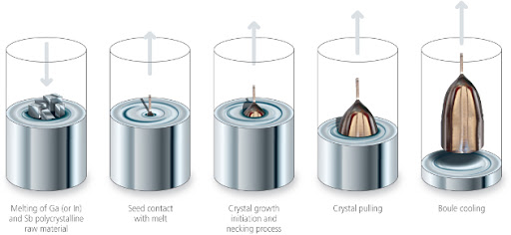
Czochralski Process

Slide 42
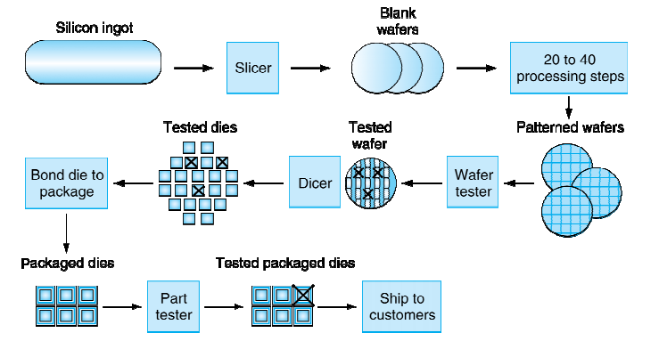
Manufacturing ICs

Slide 43

Silicon Wafer before processing

Slide 44
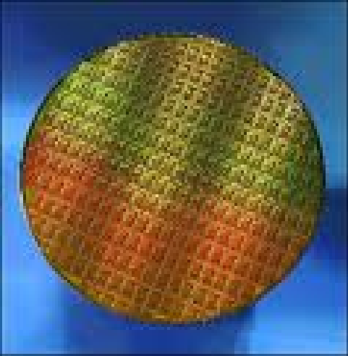
Final Silicon Wafer

Slide 45
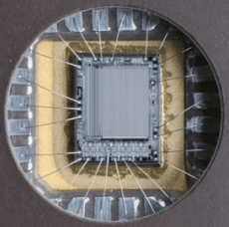
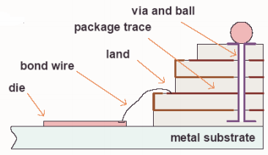
Packaging
Signal and power connections between the chip and a circuit board
Remove heat produced from the chip
Protects from mechanical and thermal damage
Cost saving

Slide 46
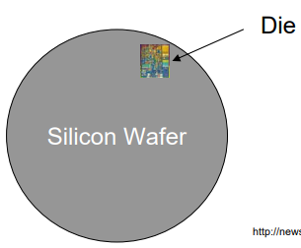
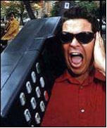
Fabrication Costs
• CPU (die) size greatly affects cost of all systems (desktop/server/embedded)
– Current CPUs 1-2 cm²
– Embedded much smaller
• cost and footprint really matters in cell phone or iPod

Slide 47
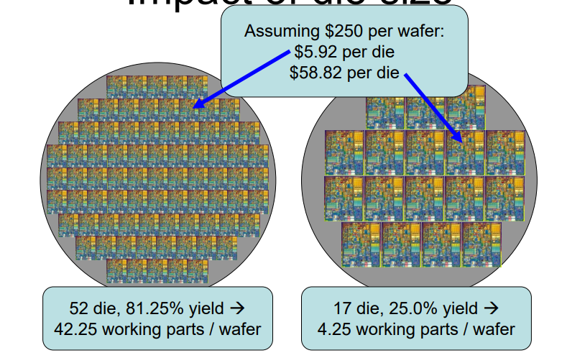
Impact of Die Size

Slide 48
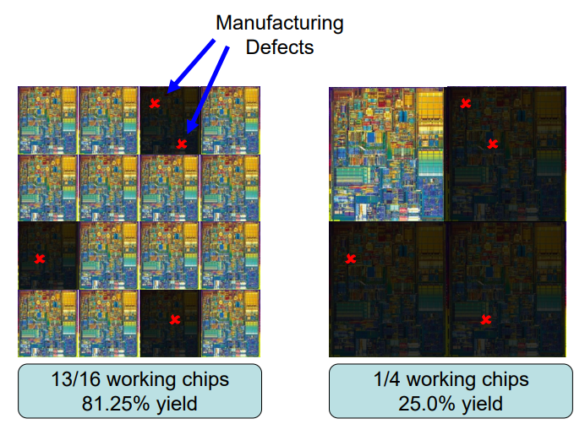
Yield

Slide 49
Interaction of Price and Performance
• Add a new architectural feature to chip
– for more performance, for less power, etc.
• Chip die size increases
– Fewer dies per wafer
– More defective dies
• Die testing more expensive
– Must test whether feature works
• Die package more expensive
– Larger package, maybe more pins
– If feature needs more power, may need better heat sink

Slide 50
Goal of Processor Design
• Maximize performance
• Within the constraints of
– Peak power, average power, thermals, die area, metal layers, reliability, manufacturing costs, implementation complexity, verification complexity, time-to-market, cost to manufacturer (Intel), cost to OEM (Dell), cost to end-customer (you).
– Which really just says:
• Maximize performance per $$$
•Huge, multi-variable optimization problem!
– Not all variables are independent
– Not all variables have the same weight
– The same variable may have different weights to different customers
Laptop/Embedded: Power, weight and size constraints are more important than in Desktop/Server world

Slide 51
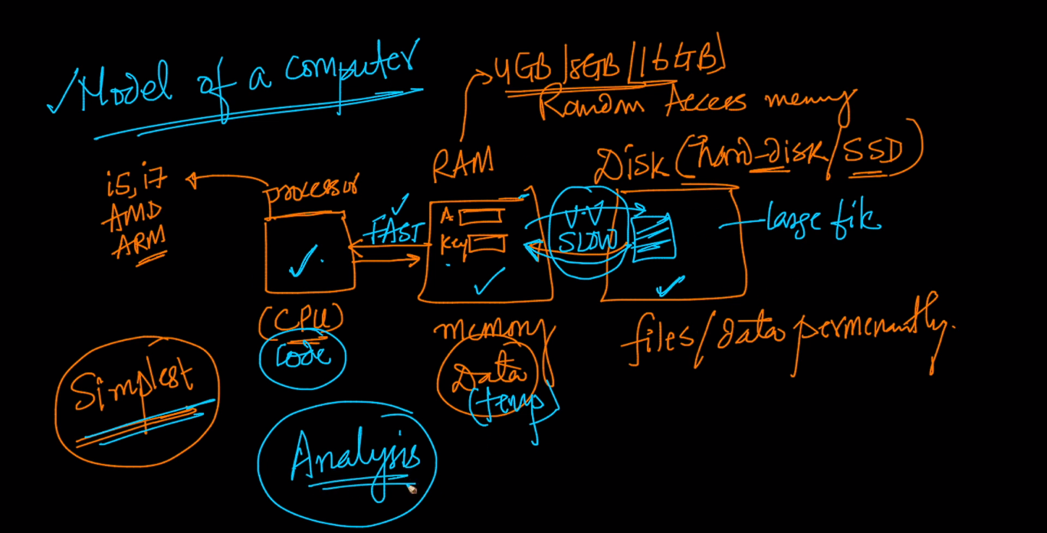
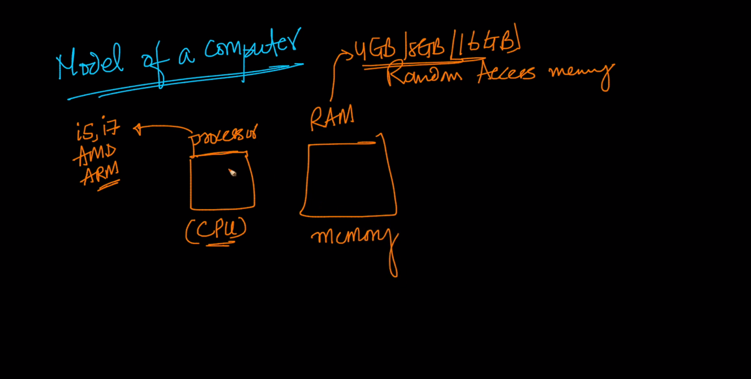
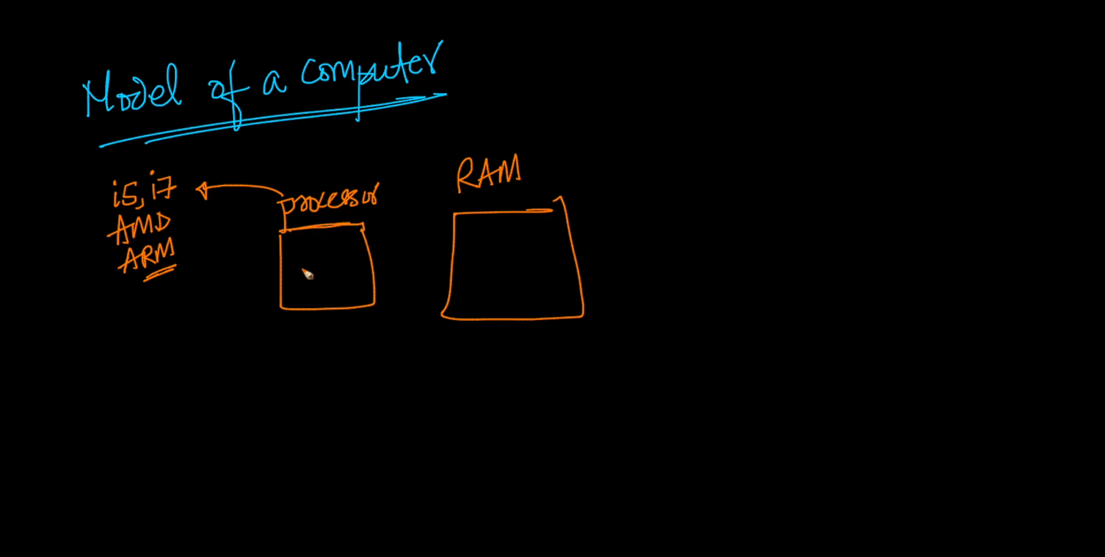






Basic Computational Model

Slide 52




Slide 53




Slide 54




Slide 55

Von-Neumann and Harvard Architecture
Two types of digital architectures
Classified by how they use memory

Slide 56
Von-Neumann Architecture
The same memory and bus are used to store both data and instructions that run the program.
Since we cannot access program memory and data memory simultaneously, the Von Neumann architecture is susceptible to bottlenecks and the system performance is affected.
The processor needs two clock cycles to complete an instruction. So, pipelining is not possible with this architecture.
In the first clock cycle, the processor gets the instruction from memory and decodes it. In the next clock cycle the required data is taken from memory. For each instruction, this cycle repeats and hence needs two cycles to complete an instruction.
Von Neumann architecture is relatively older and was replaced by Harvard architecture.

Slide 57
The Von Neumann Bottleneck
The Von Neumann bottleneck is a limitation of throughput caused by the standard personal computer architecture.
If a Von Neumann machine wants to perform an operation on some data in memory, it has to move the data across the bus into the CPU. When the computation is done, it needs to move outputs of the computation to memory across the same bus. The amount of data the bus can transfer at one time limit the speed and bandwidth of the system.
The processor can be idle while waiting for the memory fetch based on what the processor might need to do after the current operation is finished.
That limited throughput of a computer is referred to the Von Neumann bottleneck and often limits the performance of the system.

Slide 58
Harvard Architecture
The name is originated from ‘Harvard Mark I’ a relay based old computer.
The Harvard architecture stores machine instructions (program) and data in separate memory units that are connected by different buses. It means it has two separate memories for storing data and program.
Processor can complete and instruction in one cycle if appropriate pipelining strategies are implemented. Or computers designed with Harvard architecture are able to run a program and access data independently, and therefore simultaneously.
Harvard architecture has a strict separation between data and code. Thus Harvard architecture is more complicated but separate pipelines remove the bottleneck that Von Neumann creates.

Slide 59
Difference between Von Neumann and Harvard architecture
Von Neumann architecture | Harvard architecture
Named after the mathematician and early computer scientist John Von Neumann. | Name originated from ‘Harvard Mark I’, a relay based old computer.
Requires only one memory for their instruction. | Requires two memories for their instruction (program) and data.
Design is simple. | Complicated design.
Requires only one bus for instruction and data. | Requires separate bus for instruction and data.
Processor needs two clock cycles to complete an instruction. | Processor can complete an instruction in one cycle.
Low performance as compared to Harvard architecture. | Easier to pipeline, so high performance can be achieved.

Slide 60


Difference between Von Neumann and Harvard architecture
Von Neumann architecture | Harvard architecture
Cheaper. | Comparatively high cost.
Used in microcontroller and signal processing. | Used in Laptop, personal computer and workstation.

Slide 61


Questions?
shrestha.sandesh@khec.edu.np
sandeshshrestha45@gmail.com

